Slide 1
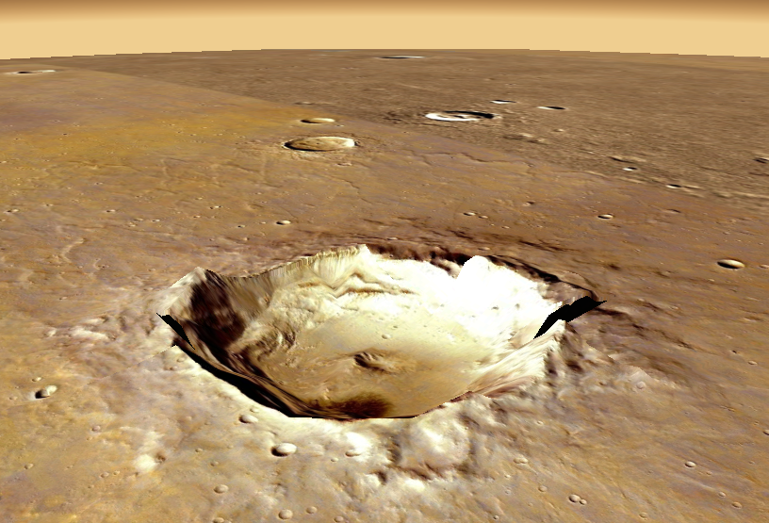
Craters on Mars
DRAFT
Google Earth

Slide 2
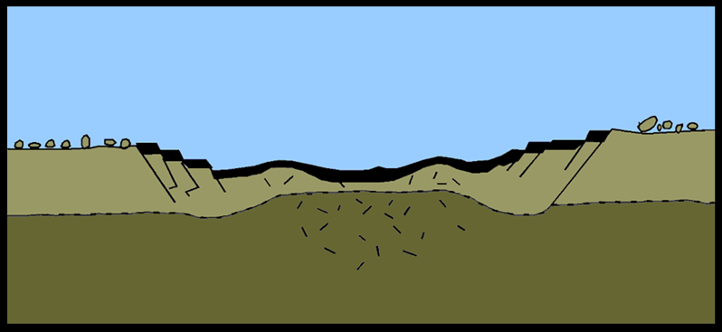
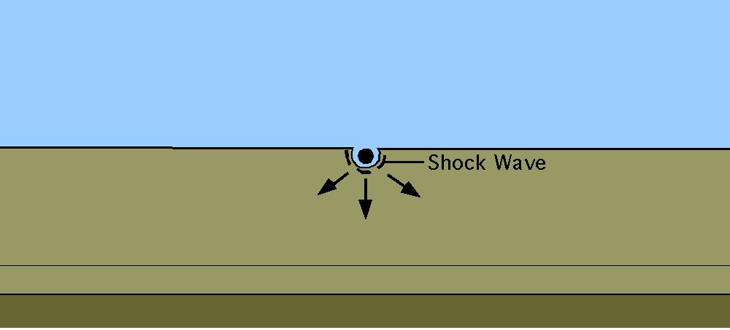
Craters form when meteorites strike the surface
In the collision the kinetic energy of the meteorite is transferred to sound, heat, chemical, elastic and gravitational potential energy leaving a crater
University of Arizona, Space Imagery Center.

Slide 3
Seismometers record the waves from the impact
The distance of the crater from the lander is found from the S – P time
P and S wave
P wave
S - P time

Slide 4
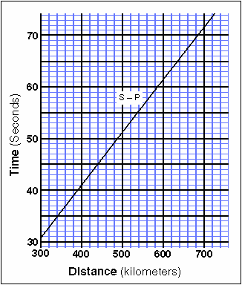
Graph of S – P time against distance
S – P time = 53 s
Distance = 520 km
S – P time

Slide 5
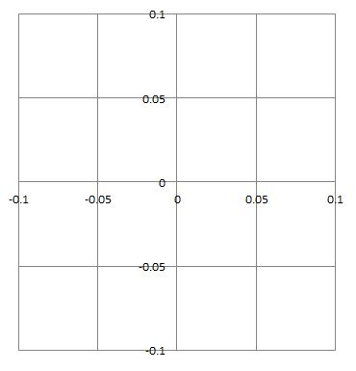
The amplitude of the waves from two seismometers is plotted. The graph gives the direction that the waves must have come from.
Seismometers
North
North - South
60⁰
East
West
East - West
South

Slide 6
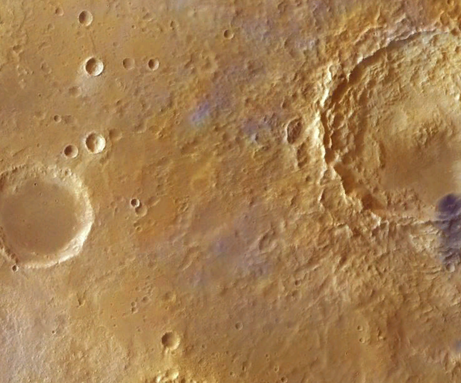
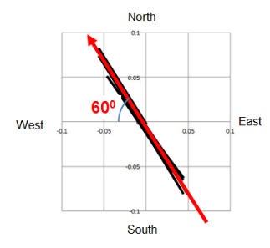
The information can but put on a map
Crater
Lander
Google Earth
The distance from the S – P time

Slide 7
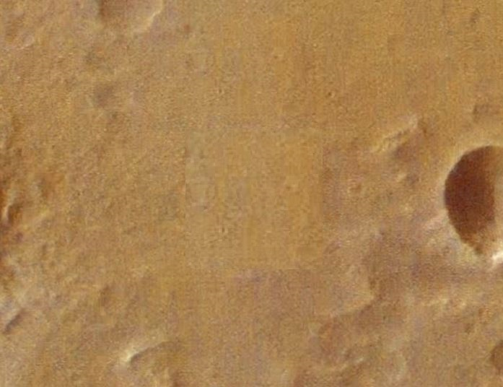
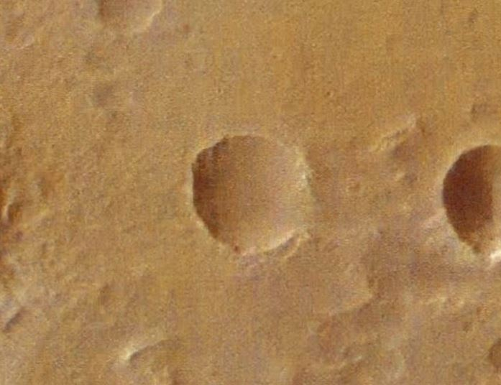
Old and new pictures can then be compared to look at the newly formed crater
Then
Now
Google Earth

